Slide 1

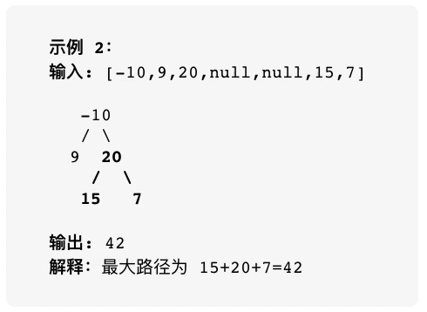
1.1
1.2

Slide 2
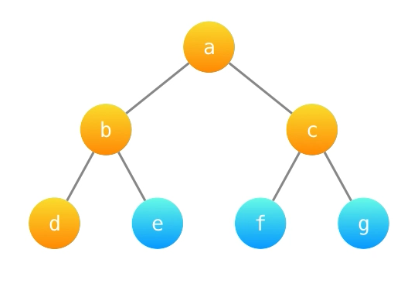

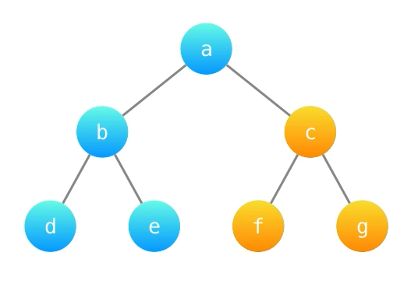
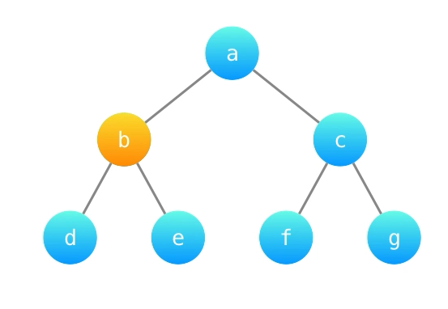
2.2
2.3
2.1
2.4

Slide 3

3

Slide 4


4.1
4.2

Slide 5

5

Slide 6

6

Slide 7
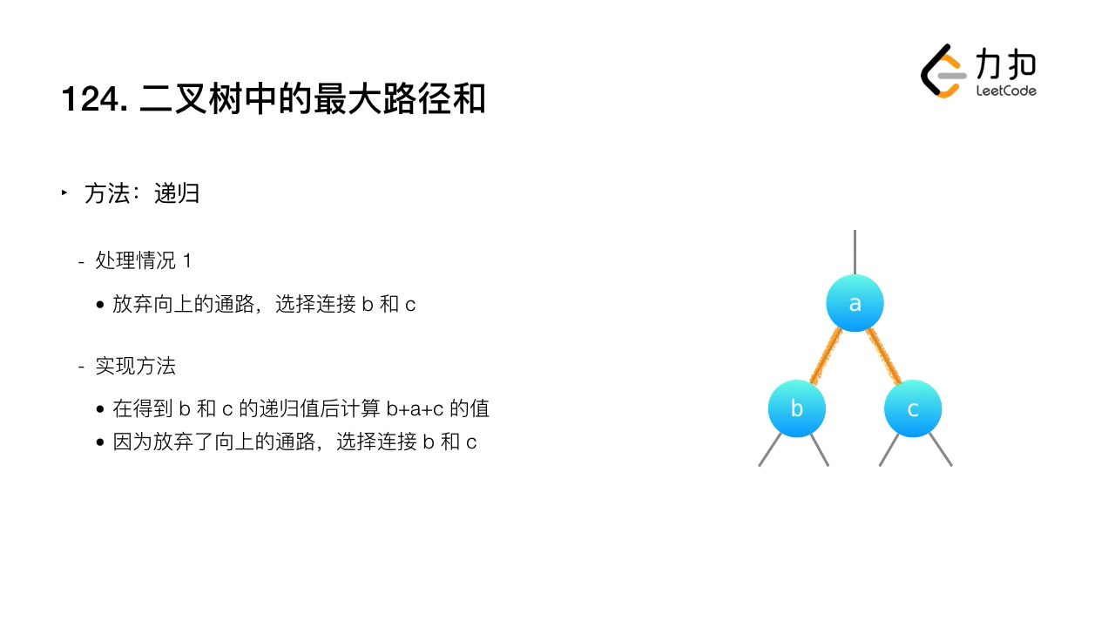
7

Slide 8

8

Slide 9
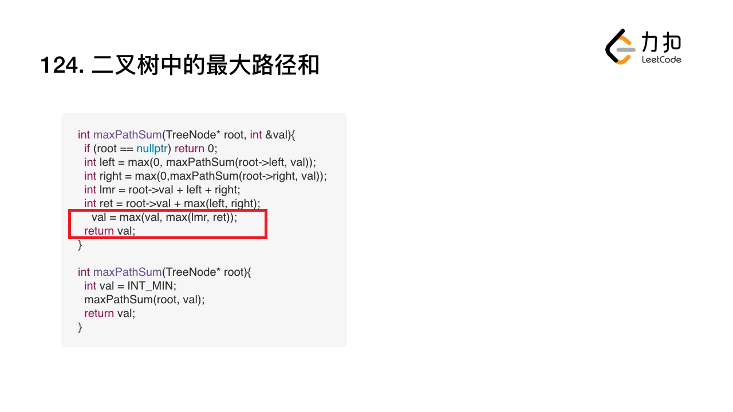
红框处有笔误
int maxPathSum(TreeNode* root, int& val)
{
if (root == nullptr) return 0;
int left = max(0, maxPathSum(root->left, val));
int right = max(0, maxPathSum(root->right, val));
int lmr = root->val + left + right;
int ret = root->val + max(left, right);
val = max(val, max(lmr, ret));
return ret;
}
int maxPathSum(TreeNode* root)
{
int val = INT_MIN;
maxPathSum(root, val);
return val;
}
9

Slide 10
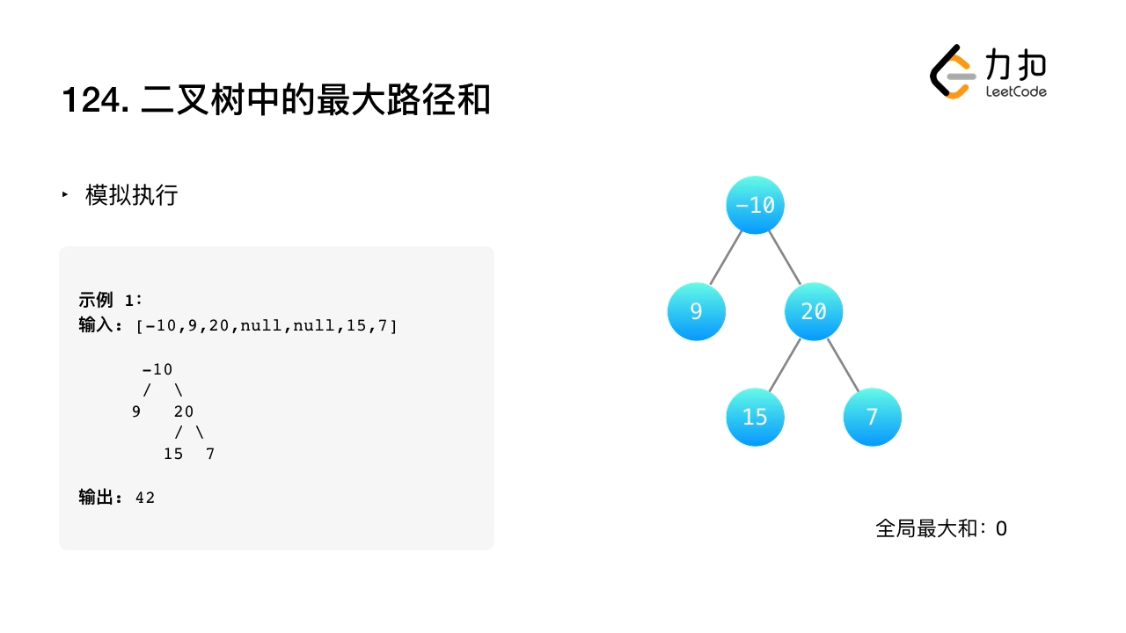
10.1

Slide 11
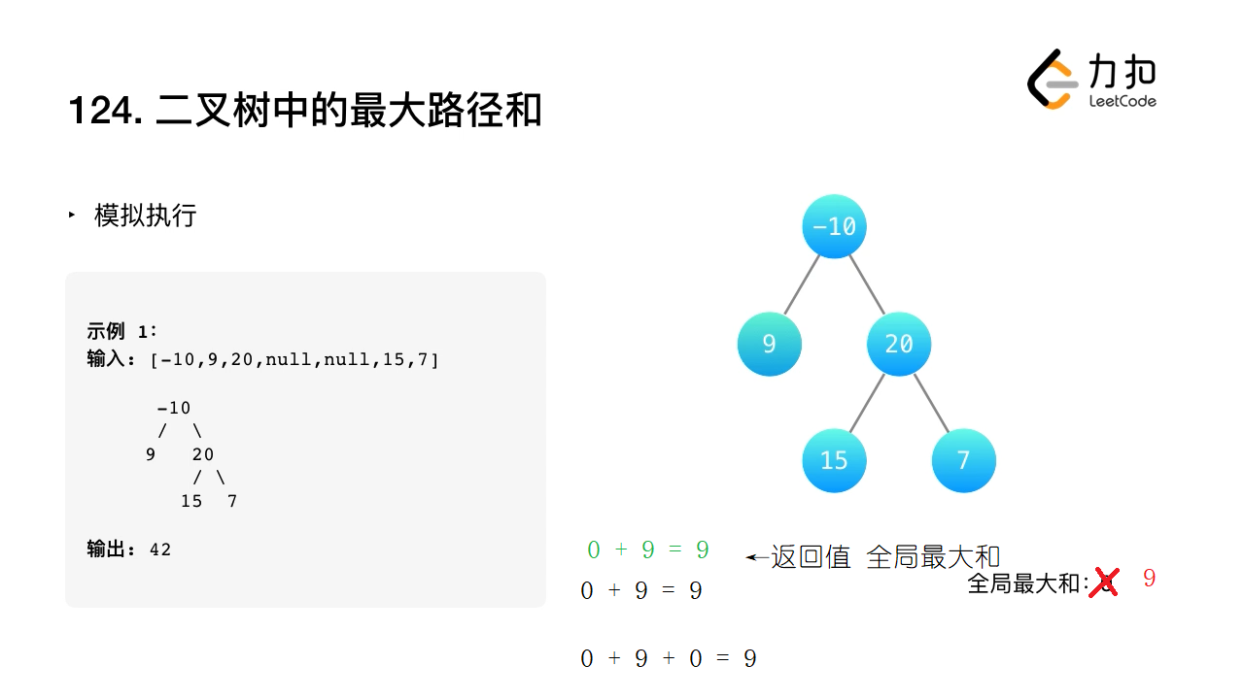
10.2

Slide 12
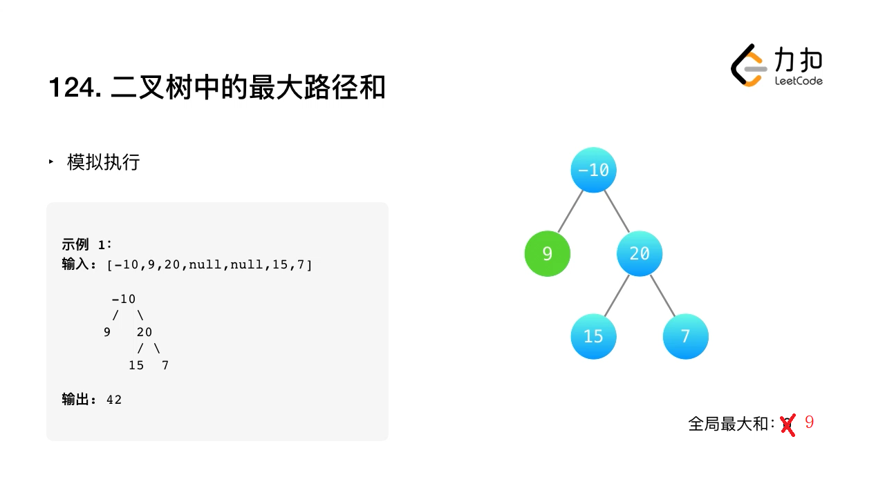
10.3

Slide 13
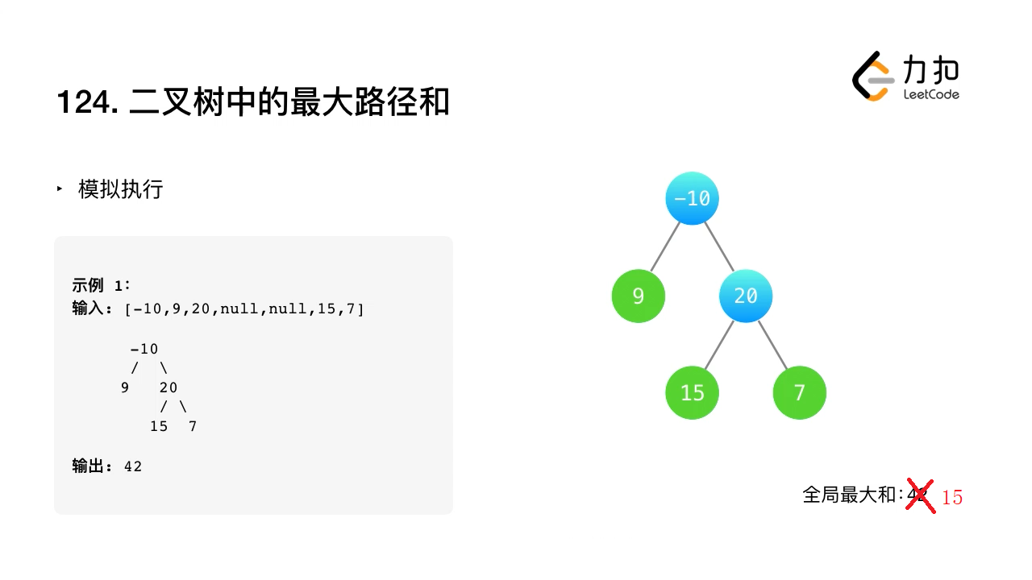
10.4

Slide 14
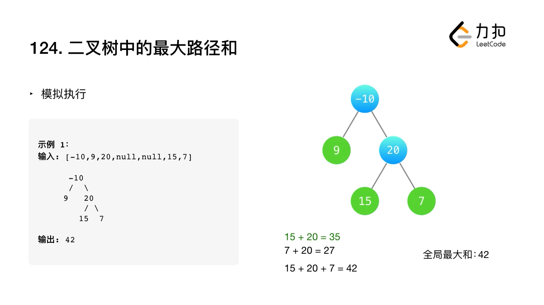
10.5

Slide 15
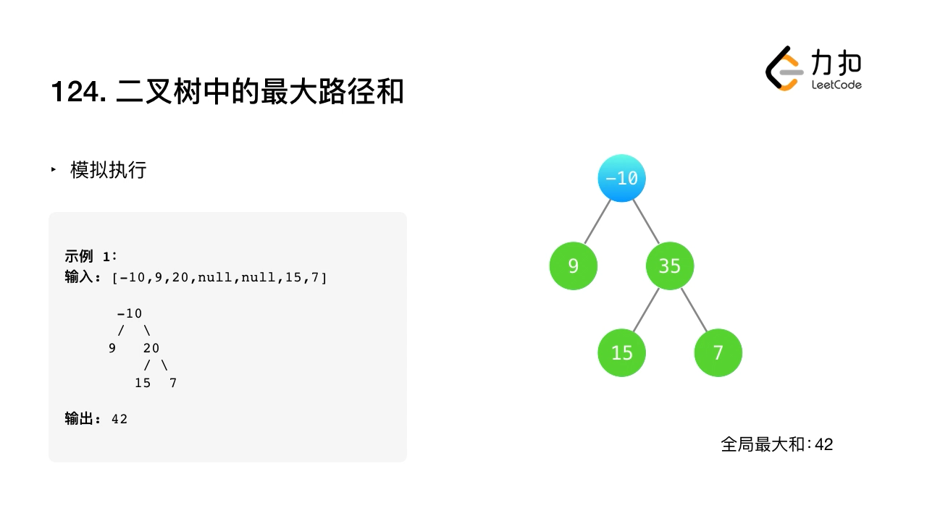
10.6

Slide 16
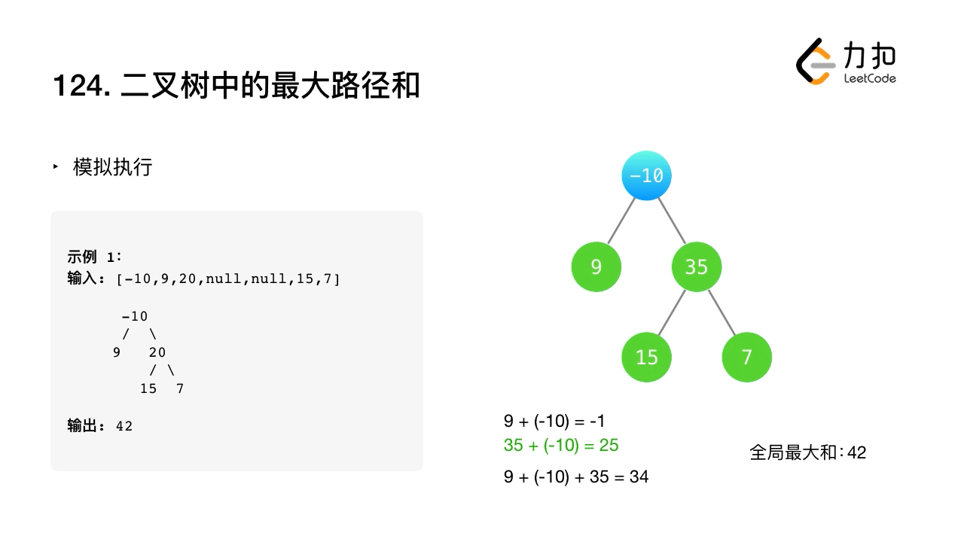
10.7

Slide 17
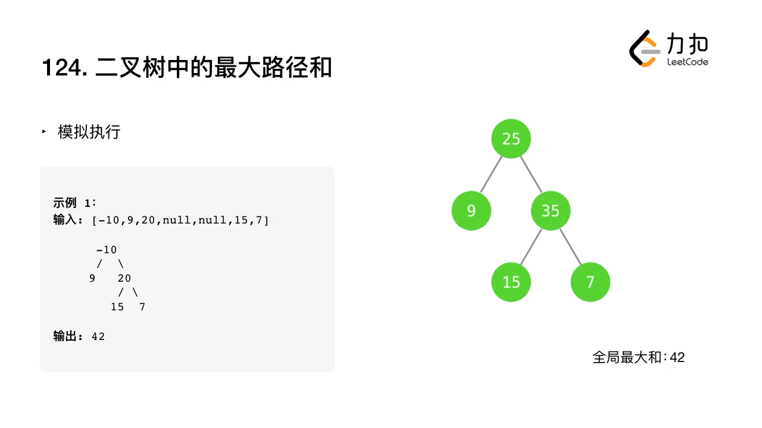
10.8

